Slide 1
Water-fall Model
Ajay Mohan
Amol mishra
Dev M M
Syeda Nida Seher
Shivam Singh

Slide 2
Introduction
History of Water Fall Model
The first formal description of the waterfall model is often cited as a 1970 article by Winston W. Royce
Royce did not use the term "waterfall" in this article.
Royce presented this model as anexample of a flawed, non-workingmodel.

Slide 3
Definition:
The waterfall model is a classical model used in system development life cycle to create a system with a linear and sequential approach. It is termed as waterfall because the model develops systematically from one phase to another in a downward fashion. This model is divided into different phases and the output of one phase is used as the input of the next phase. Every phase has to be completed before the next phase starts and there is no overlapping of the phases.

Slide 4
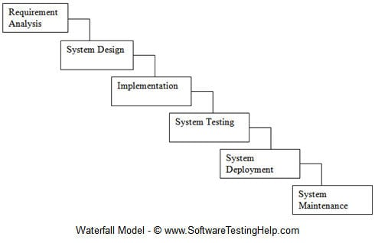
Explaination

Slide 5
Sequential phases in Waterfall model are −
Requirement Gathering and analysis − All possible requirements of the system to be developed are captured in this phase and documented in a requirement specification document.System
Design − The requirement specifications from first phase are studied in this phase and the system design is prepared. This system design helps in specifying hardware and system requirements and helps in defining the overall system architecture.
Implementation − With inputs from the system design, the system is first developed in small programs called units, which are integrated in the next phase. Each unit is developed and tested for its functionality, which is referred to as Unit Testing.

Slide 6
Sequential phases in Waterfall model are −
Integration and Testing − All the units developed in the implementation phase are integrated into a system after testing of each unit. Post integration the entire system is tested for any faults and failures.
Deployment of system − Once the functional and non-functional testing is done; the product is deployed in the customer environment or released into the market.
Maintenance − There are some issues which come up in the client environment. To fix those issues, patches are released. Also to enhance the product some better versions are released. Maintenance is done to deliver these changes in the customer environment.

Slide 7
Merits of Waterfall model in SDLC
Simple and easy to understand and use.-
For smaller projects, the waterfall model works well and yield the appropriate results.
Since the phases are rigid and precise, one phase is done one at a time, it is easy to maintain.
The entry and exit criteria are well defined, so it easy and systematic to proceed with quality.
Results are well documented

Slide 8
De-merits of Waterfall model in SDLC
Cannot adopt the changes in requirements.
It becomes very difficult to move back to the phase. For example, if the application has now moved to the testing stage and there is a change in requirement, It becomes difficult to go back and change it.
Delivery of the final product is late as there is no prototype which is demonstrated intermediately.
For bigger and complex projects, this model is not good as a risk factor is higher.
Not suitable for the projects where requirements are changed frequently.
Does not work for long and ongoing projects.
Since the testing is done at a later stage, it does not allow identifying the challenges and risks in the earlier phase so the risk mitigation strategy is difficult to prepare.

Slide 9
Projects where we use waterfall model
Examples of Waterfall ModelIn the olden days,
Waterfall model was used to develop enterprise applications like Customer Relationship Management (CRM) systems, Human Resource Management Systems (HRMS), Supply Chain Management Systems, Inventory Management Systems, Point of Sales (POS) systems for Retail chains etc.
Waterfall model was used significantly in the development of software till the year 2000. Even after the Agile manifesto was published in 2001, Waterfall model continued to be used by many organization till the last decade.

Slide 10
THANK
YOU

